Slide 2
Comparing Computer Performance Using Execution Time
To compare the performance of two machines “A”, “B” running a given specific program
Performance_{A} = 1 / Execution Time_{A}
Performance_{B} = 1 / Execution Time_{B}
Machine A is n times faster than machine B means:
Example:
For a given program:
  Execution time on machine A: Execution_{A} = 1 second
  Execution time on machine B: Execution_{B} = 10 seconds
  Performance_{A} / Performance_{B} = Execution Time_{B} / Execution Time_{A}
  = 10 / 1 = 10
  The performance of machine A is 10 times the performance of machine B when
  running this program, or: Machine A is said to be 10 times faster than machine B
  when running this program.
Performance_{A}
Execution Time_{B}
Speedup = n = =
Performance_{B}
Execution Time_{A}

Slide 3
CPU Execution Time
The CPU Equation
A program is comprised of a number of instructions executed , I
  Measured in: instructions/program
The average instruction takes a number of cycles per instruction (CPI) to be completed.
  Measured in: cycles/instruction, CPI
CPU has a fixed clock cycle time C = 1/clock rate
  Measured in: seconds/cycle
CPU execution time is the product of the above three parameters as follows:
CPU time = Seconds = Instructions x Cycles x Seconds
Program Program Instruction Cycle
T = I x CPI x C

Slide 4
Example
A Program is running on a specific machine with the following parameters:
  Total executed instruction count: 10,000,000 instructions
  Average CPI for the program: 2.5 cycles/instruction.
  CPU clock rate: 200 MHz.
What is the execution time for this program?
CPU time = Instruction count x CPI x Clock cycle
= 10,000,000 x 2.5 x 1 / clock rate
= 10,000,000 x 2.5 x 5x10⁻⁹
= .125 seconds

Slide 5
Example
From the previous example: A Program is running on a specific machine with the following parameters:
  Total executed instruction count, I: 10,000,000 instructions
  Average CPI for the program: 2.5 cycles/instruction.
  CPU clock rate: 200 MHz.
Using the same program with these changes:
  A new compiler used: New instruction count 9,500,000
  New CPI: 3.0
  Faster CPU implementation: New clock rate = 300 MHZ
What is the speedup with the changes?
Speedup = (10,000,000 x 2.5 x 5x10⁻⁹) / (9,500,000 x 3 x 3.33x10⁻⁹ )
= .125 / .095 = 1.32
or 32 % faster after changes.
Speedup = Old Execution Time = I_{old} x CPI_{old} x Clock cycle_{old}
New Execution Time I_{new} x CPI_{new} x Clock Cycle_{new}

Slide 6
Amdahl's law

Slide 7
Example from Wikipedia
Suppose a task is split into four consecutive parts: P1 ( takes 11% of the time required), P2(18%), P3(23%) and P4(48%).
Further suppose Then that part P1 is not speed up, while P2 is sped up by a factor of 5 times, P3 is speed up 20×, and P4 is sped up 1.6×.

Slide 8
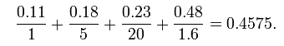

Improvement in speed
The 11% still takes the same amount of time, while the 18% is divided by 5 (i.e. is 5 times faster), etc.
If the original time was 1, the new time is 0.4575 – a little more than twice as fast. Speed is:

Slide 9
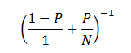
Amdahl’s law
In Amdahl’s Law we break the process into two pieces – a parallelizable part P and a non-parallelizable part (1-P).
If we assume that there are N processors (or pipelines or whatever) then the improvement of the parallelizable part is N.

Slide 10
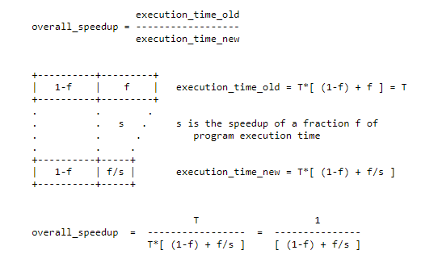

Slide 11
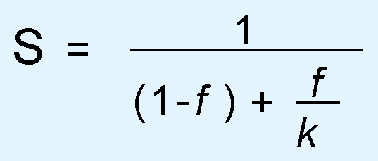
Amdahl’s Law
The overall performance of a system is a result of the interaction of all of its components.
System performance is most effectively improved when the performance of the most heavily used components is improved.
This idea is quantified by Amdahl’s Law:
  where S is the overall speedup;
  f is the fraction of work performed by a faster component; and
  k is the speedup of the faster component.

Slide 12
Examples
if 90% of a calculation can be parallelized (i.e. 10% is sequential) then the maximum speed-up which can be achieved on 5 processors is 1/(0.1+0.9/5) or roughly 3.6 (i.e. the program can theoretically run 3.6 times faster on five processors than on one)

Slide 13
Examples
If 90% of a calculation can be parallelized then the maximum speed-up on 10 processors is
1/(0.1+(1-0.1)/10) or 5.3 (i.e. investing twice as much hardware speeds the calculation up by about 50%).
If 90% of a calculation can be parallelized then the maximum speed-up on 20 processors is
1/(0.1+(1-0.1)/20) or 6.9 (i.e. doubling the hardware again speeds up the calculation by only 30%).

Slide 14
Examples
if 90% of a calculation can be parallelized then the maximum speed-up on 1000 processors is
1/(0.1+(1-0.1)/1000) or 9.9 (i.e. throwing an absurd amount of hardware at the calculation results in a maximum theoretical (i.e. actual results will be worse) speed-up of 9.9 vs a single processor).

Slide 15
Essence
The point that Amdahl was trying to make was that using lots of parallel processors was not a viable way of achieving the sort of speed-ups that people were looking for. i.e. it was essentially an argument in support of investing effort in making single processor systems run faster.

Slide 16
MAXIMUM THEORETICAL SPEED-UP
Amdahl's Law is a statement of the maximum theoretical speed-up you can ever hope to achieve. The actual speed-ups are always less than the speed-up predicted by Amdahl's Law

Slide 17
Why actual speed ups are always less ?
distributing work to the parallel processors and collecting the results back together is extra work required in the parallel version which isn't required in the serial version

Slide 18
Amdahl’s Law
On a large system, suppose we can upgrade a CPU to make it 50% faster for $10,000 or upgrade its disk drives for $7,000 to make them 150% faster.
Processes spend 70% of their time running in the CPU and 30% of their time waiting for disk service.
An upgrade of which component would offer the greater benefit for the lesser cost?

Slide 19
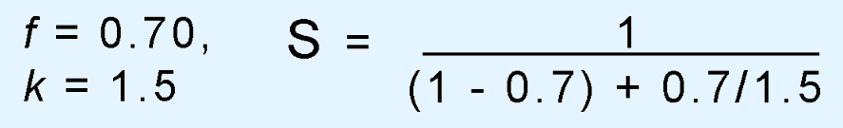
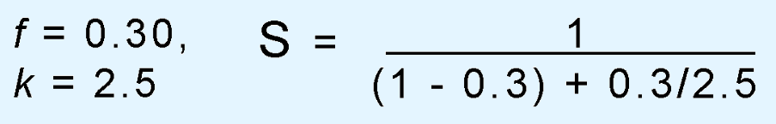
Amdahl’s Law
The processor option offers a 130% speedup:
And the disk drive option gives a 122% speedup:

Slide 20
Consider memory access time. If a cache is ten times faster than main memory, and if the cache can be used 90% of the time, what overall speedup in memory access time do we gain by using the cache?

Slide 21
overall_speedup = 1/[ (1-f) + f/s ]
    = 1/[ (1-.9) + .9/10 ]
    = 1/[ .1 + .09 ]
    = 1/.19
    = 5.26

Slide 22
Consider enhancing a scalar machine by providing a vector mode. When a computation is run in vector mode it is 16 times faster than the normal mode of operation. What percent of vectorization is needed to achieve an overall speedup of 4?

Slide 23
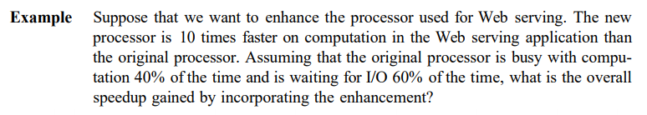

Slide 24


Slide 25
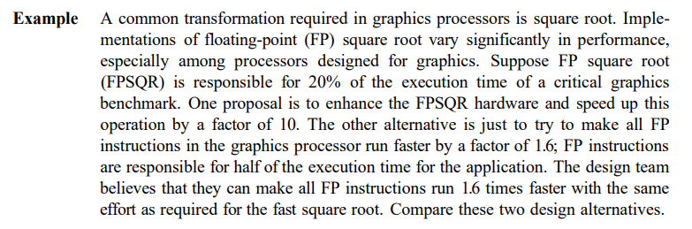

Slide 26
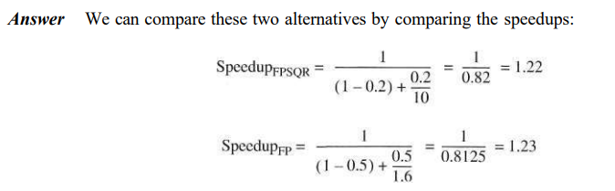


Slide 27
Amdahl’s law
If a program currently takes 100 seconds to execute and loads and stores account for 20% of the execution times, how long will the program take if loads and stores are made 30% faster?
For this, you can use Amdahl's law or you can reason it out step by step. Doing it step by step gives .Before the improvement loads take 20 seconds
    If loads and stores are made 30 percent faster they will take 20/1.3 = 15.385 seconds, which corresponds to 4.615 seconds less.
    Thus, the final program will take 100 - 4.615 = 95.38

